Slide 1
Biometric Security - Benchmarks
Drake Csage, Ben Strandskov, Niall Mulcahy, Laurie Fitzek

Slide 2
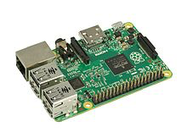
Evaluating Success vs. Failure
Integrating the cloud computing in our project.
Real time data and statistics.
Learning the complex python algorithms.
Evaluating facial recognition at a given point in time.
Evaluating thumbprint recognition at a given point in time.
Integrating GPS location or GPS tracking.
Theoretically unlocking the car.

Slide 3
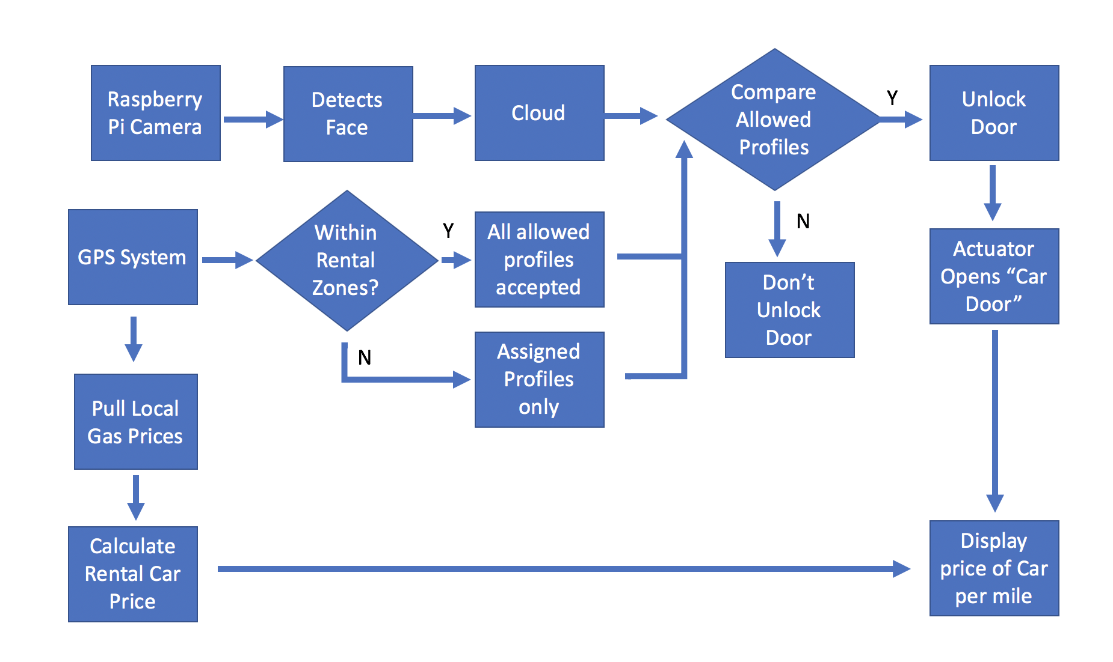
Flow Chart Diagram

